Slide 1
K-XMSS and K-SPHINCS+ : Hash based Signature with Korean Cryptography Algorithms
Minjoo Sim, Siwoo Eum, Gyeongju Song,
Yujin Yang, Wonwoong Kim and Hwajeong Seo
https://youtu.be/QdiVGacvn2E

Slide 2
Contents
Our Contribution
Related Work
Proposed Method
Evaluation
Conclusion

Slide 3
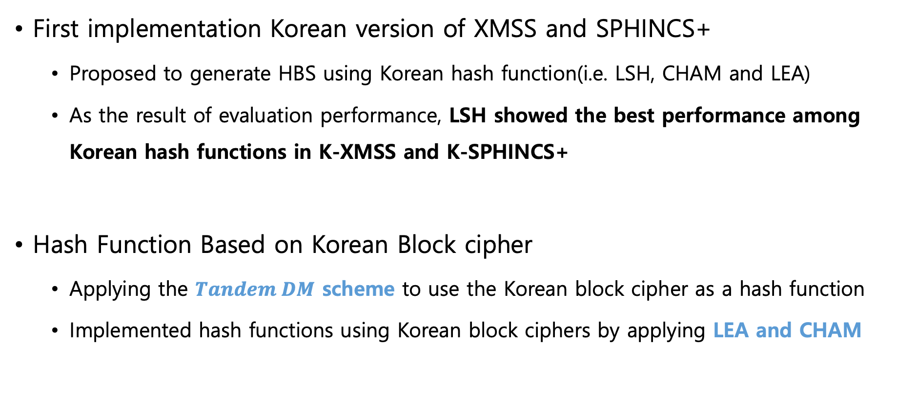
Our contribution
First implementation Korean version of XMSS and SPHINCS+
Proposed to generate HBS using Korean hash function(i.e. LSH, CHAM and LEA)
As the result of evaluation performance, LSH showed the best performance among Korean hash functions in K-XMSS and K-SPHINCS+
Hash Function Based on Korean Block cipher
Applying the $Tandem DM$ scheme to use the Korean block cipher as a hash function
Implemented hash functions using Korean block ciphers by applying LEA and CHAM

Slide 4
XMSS
Stateful Hash-Based-Signature(HBS) scheme based on the Merkle Signature Scheme(MSS)
Using WOTS+(Winternitz One Time Signature Plus) as the main building block
Using one key pair consisting of a private key and a public key
To ensure the security of XMSS, the used key pair should not be used again

Slide 5
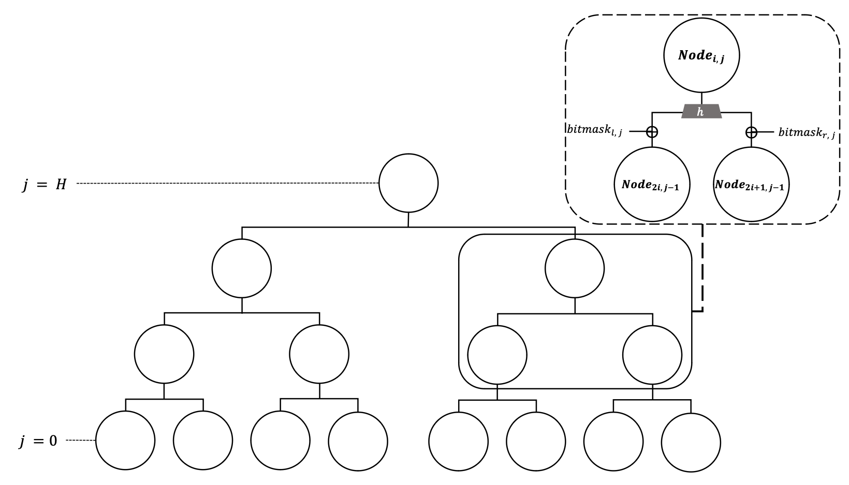
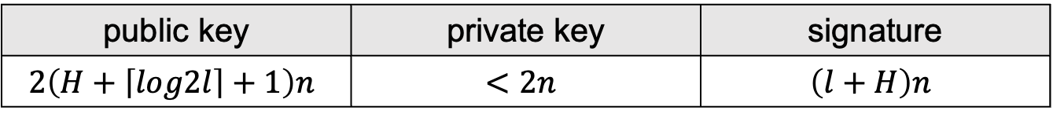
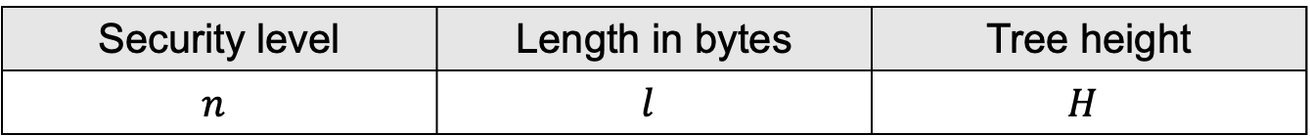
XMSS
As a result, the root node of the Merkle tree becomes the final XMSS public key
Security level | Length in bytes | Tree height
$$n$$ | $$l$$ | $$H$$
public key | private key | signature
$$2\left(H+\left\lceil log2l\right\rceil +1\right)n$$ | $$<2n$$ | $$\left(l+H\right)n$$

Slide 6
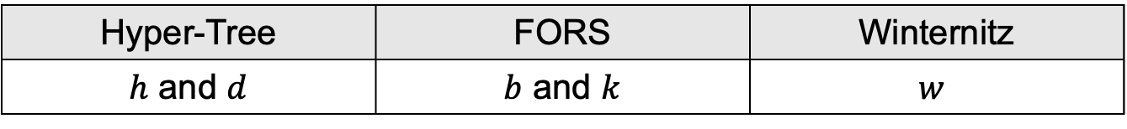
SPHINCS+
Stateless HBS scheme
Improve the speed and signature size of SPHINCS
The main contribution of SPHINCS+
Introduction of FORS( FORS is few-time signature scheme)
Selecting leaf nodes
Hyper-Tree | FORS | Winternitz
$h$ and $d$ | $b$ and $k$ | $$w$$
Parameter of SPHINCS+

Slide 7
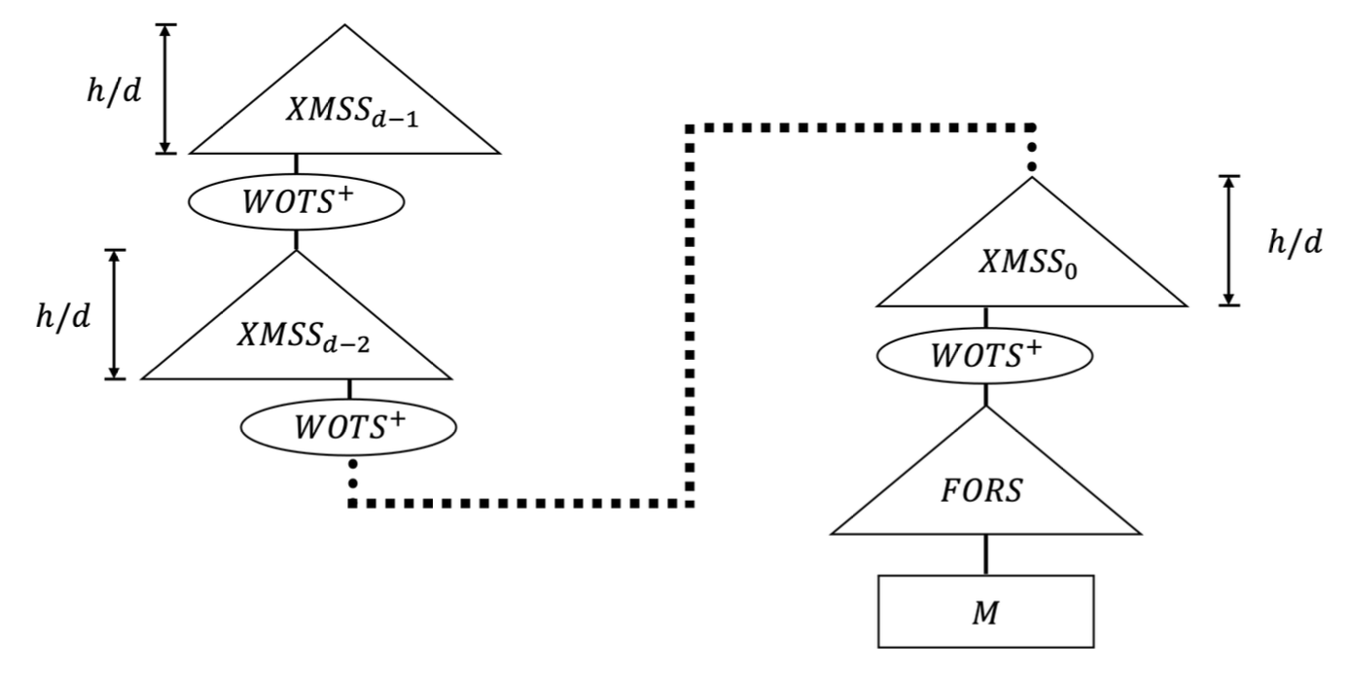

SPHINCS+
SPHINCS+ is a Hyper-tree of height $h$ and consists of $d$ tree
In the hyper-tree, layer($d−1$) has a single tree and layer($d−2$) has $2h/d$ tress
The root of the layer$(d−2)$tree is signed using the WOTS+ key pair in the layer$(d−1)$tree

Slide 8
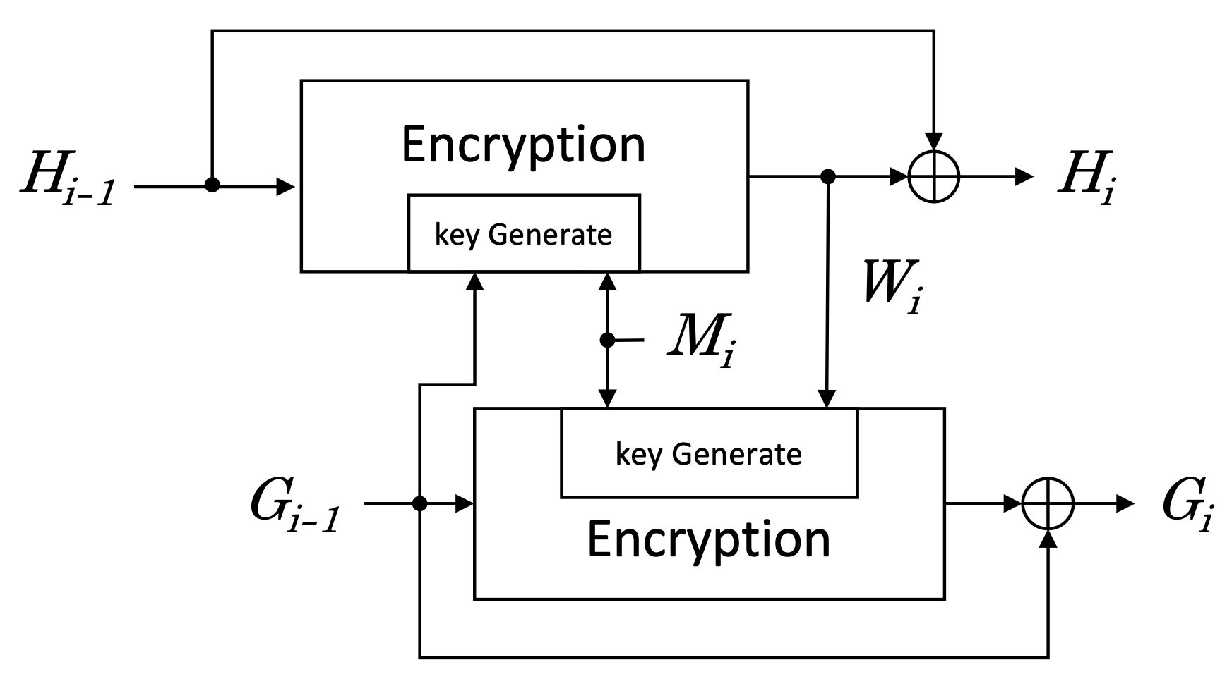
Hash Function Based on Block cipher
Hash function based on block cipher uses a block cipher algorithm instead of a hash round function
Several structures have been proposed to output the desired length of hash
Tandem DM structure applies a block cipher algorithm
Key length of 2m-bit when the block length is m-bit
Output hash length is 2m-bit

Slide 9
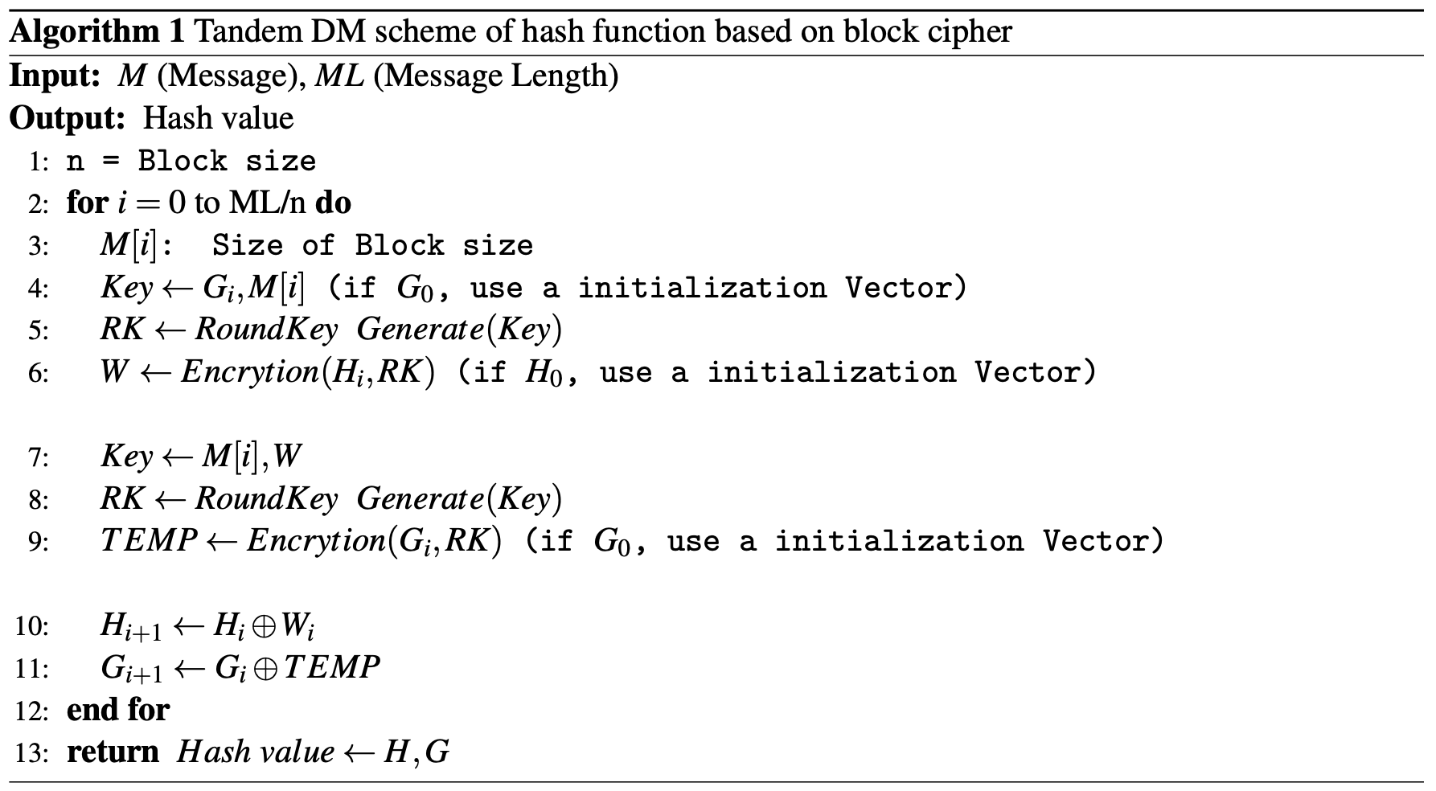

Hash Function Based on Block cipher
We construct hash function based on the Tandem DM scheme and utilize CHAM and LEA as the underlying block ciphers
Algorithm 1 show Tandem DM scheme
In line 4, $G_{i}$ for upper bit and $M[i]$ for lower bit are used as the key
In line 7, $G_{i}$ for upper bit and $W$for lower bit are used as the key
Generate a roundkey through
the Roundkey generate function
key initialization
Generate an encrypted value through
an Encryption function

Slide 10
K-XMSS
We replaced the hash functions (SHA2 and SHAKE) used in the original XMSS to Korean cryptography algorithms
Utilized LSH hash function and hash function based on block cipher (CHAM and LEA)
We developed the code based on the basic C reference of XMSS
K-XMSS adopted the same parameters and structures utilized in XMSS
w | n | Hash Function
16 | 32 | LSH-256, CHAM and LEA
 | 64 | LSH-512
Parameter of K-XMSS

Slide 11
K-SPHINCS+
We replaced the hash functions (SHA2, SHAKE, and HARAKA) used in the original SPHINCS+ to Korean hash functions (LSH, CHAM, and LEA)
We set the hash function parameters (n, h, d, k and w) used in SPHINCS+ to be the same in K- SPHINCS+
Implemented it based on hash function-256(LSH-256, CHAM and LEA)

Slide 12
Evaluation
K-XMSS vs XMSS
XMSS was evaluated using test/speed.c included in the basic C reference code
SHA2 in XMSS used the OpenSSL library, and in the case of SHAKE, the optimally implemented code for XMSS operations
In contrast, LSH uses a basic C reference and the hash function our implementations based on CHAM and LEA

Slide 13
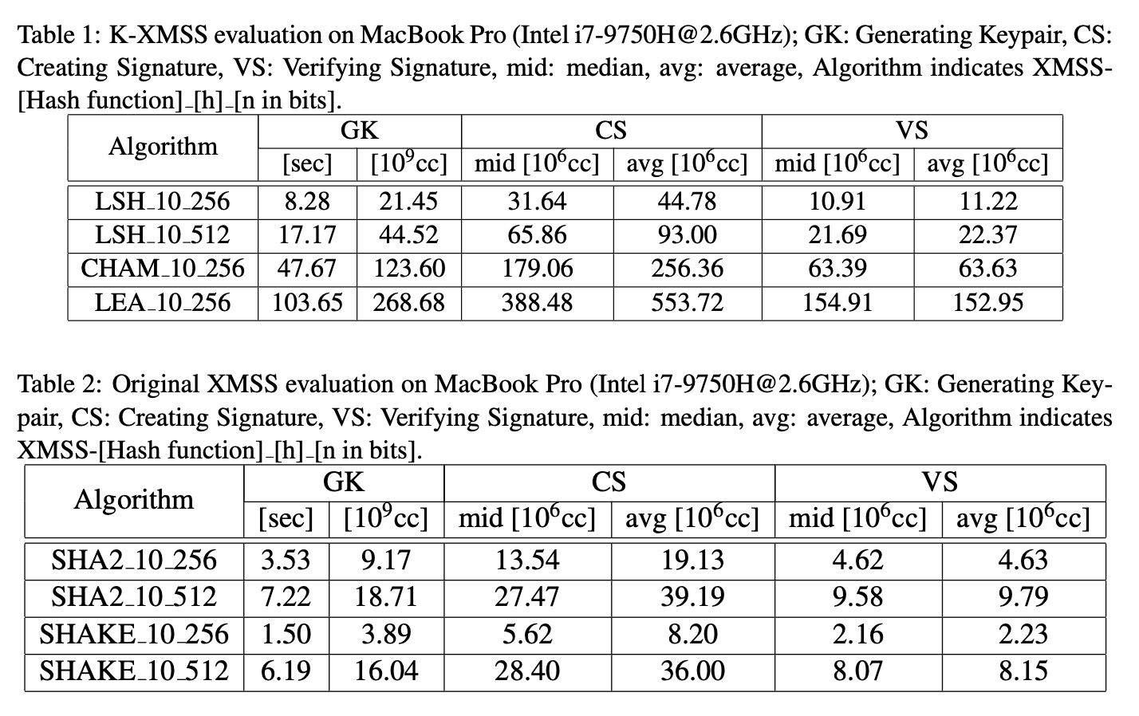
Evaluation
K-XMSS vs XMSS
LSH was significantly faster than other Korean hash ciphers
SHAKE was about 2 times faster than that of SHA2
As the result, LSH performance was about 2 times lower than that of the SHA2 during the entire operation process

Slide 14
Evaluation
K-SPHINSC+ vs SPHINSC+
SPHINCS+ was evaluated based on the simple code of the PQClean project
K-SPHINCS+ was evaluated by changing the hash function to a Korean hash function for the same code

Slide 15
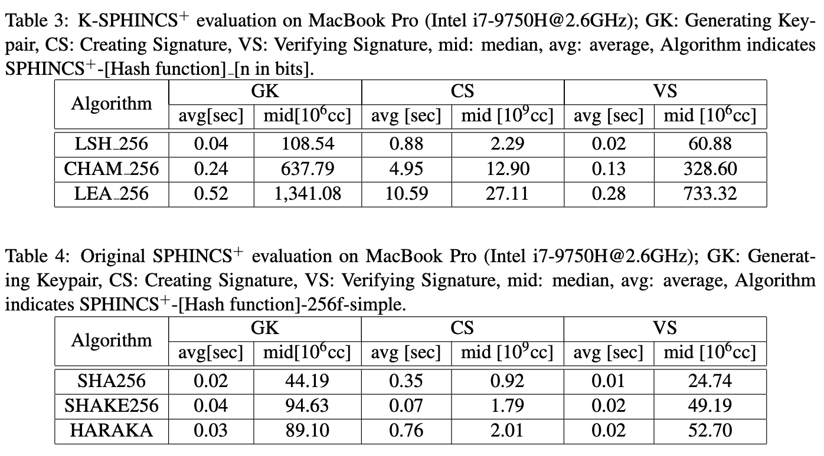
Evaluation
K-SPHINSC+ vs SPHINSC+
LSH was significantly faster than other Korean hash ciphers
SHA2 was about 2 faster than that of SHAKE or HARAKA
As the result, it was confirmed that the LSH performance was about 2 times lower than that of SHA2 in the entire operation process

Slide 16
Conclusion
We proposed K-XMSS, K-SHPINCS+, which changed the hash functions of XMSS and SHPINCS+ to Korean hash functions (LSH, CHAM, and LEA)
As the result, LSH was significantly faster than other hash ciphers of K-XMSS and K-SPHINCS+
But their performance was evaluated to be lower than that of SHA2, SHAKE, and HARAKA
In Future work, this performance can be further optimized by adopting the optimal implementation code (e.g. AVX2 or NEON)

Slide 17
Thank you!

